Slide 1
Keystone Bootloader

Slide 2
Agenda
The BOOT
Motivation
RBL
Boot Modes
configuration pins
magic address
triggering and reset
File formats
DSP formats
ARM formats
TI Tools

Slide 3
Agenda
modes details
DSP
ARM
Two step boot
IBL
Boot multiple cores
U-boot

Slide 4
Agenda
The BOOT
Motivation
RBL

Slide 5
Some Lines from the Gel routine at connect
Global_Default_Setup_Silent()
{
Set_DSP_Cache();
if (DNUM == 0)
{
status = Init_PLL(PLL1_M, PLL1_D);
// Setup all Power Domains on
Set_Psc_All_On( );
}
// Setup Pll3 pass clk @ 1050 MHz
Init_Pll3(PLLM_PASS, PLLD_PASS);
// Setup Pll2 DDR3 PLL @ 667 MHz
Init_Pll2(PLLM_DDR, PLLD_DDR);
xmc_setup();
ddr3_setup_auto_lvl_1333(0);
}
// Configure SGMII SERDES
configSGMIISerdes();
EnableEDC_OneforAll();
GEL_TextOut( "Configuring CPSW ...\n");
setCpSwConfig();
}

Slide 6
Some Lines from the Gel routine during load
OnFileLoaded(int nErrorCode, int bSymbolsOnly)
{
// Allows only core 0 can do i2c programming
if (DNUM == 0)
{
// Checks if eeprom i2c programming was started
if (i2cprog!=0)
{
// Test for little endian
if (i2cprog==LITTLE_END)
{
// For little endian
// Remove i2c eeprom switch
i2cprog=0;
// Load data file to program
GEL_MemoryLoad(0x900000, 0, 0x10000, "$(GEL_file_dir)\\dsprom.dat");
// Load i2c programmer parameters file
GEL_MemoryLoad(0x800000, 0, 0x60, "$(GEL_file_dir)\\..\\i2crom\\params_le.dat");
// Programs the dsp eeprom
GEL_Run();
}

Slide 7
Generic Boot Procedure

Slide 8
Rom Boot Loader (RBL): Definition
Rom Boot Loader (RBL):
Software code used for device startup.
Burned in ROM (non-modifiable) during manufacture
Has a base address of 0x20B00000 (DSP), 0x00000000 (ARM)
RBL can be executed by C66x core or the ARM core. The boot behavior varies depending on the core type that initiates the boot process.
C66x CorePac
ROM
ARM CorePac

Slide 9
Rom Boot Loader (RBL): Purpose
RBL enables user to transfer application code from memory or host to high speed internal memory or DDR3.
RBL provides multiple choices to the user to boot the device.
These boot choices can be broadly divided into two groups:
Memory boot where the application code is stored in a slow external memory and DSP acts as a master and drives the boot process.
Host Boot where the DSP is configured as a slave and driven by a host device connected through fast transport.

Slide 10
Boot Process Requirements
Selecting the method of booting
what CPU (ARM 0 or DSP core 0) does the boot
All other cores are in idle, waiting for interrupt
What boot mode to use
Updating the configuration
Trigger to use the configuration to prepare for booting
Configuring the device (PLLs and more)
Load the image of the executable into the device
Trigger all cores to run the executable

Slide 11
DSP Boot Loader (RBL)
RBL responsible for device start up and transfers application code from memory or host to high speed internal memory or DDR3
RBL code is burned in the DSP ROM Base address f0x20B00000
Various boot modes are supported
These boot modes are broadly divided into tree groups
Memory boot where the application code is stored in a slow external memory and DSP acts as a master and drives the boot process.
Host boot with the host having the knowledge of the memory map of the boot device
Host boot with host unaware of the memory structure of the boot device

Slide 12
ARM boot loader
RBL responsible for device start up and transfers application code from memory or host to high speed internal memory or DDR3
RBL code is burned in the ROM (Non-modifiable)
Base address for the ARM RBL is 0x00000000
The boot behavior changes based on the boot modes.
Boot modes are broadly divided in 3 categories
Memory Boot
Host boot with the host having the knowledge of the memory map of the boot device
Host boot with host unaware of the memory structure of the boot device.

Slide 13
More about BOOT Modes
Master Mode – CPU manages the boot process
Either DSP core 0 or ARM A15 core 0
CPU configures peripheral and reads the boot information
Example – I2C master mode
Slave Mode Direct IO – CPU needs to configure a peripheral
External master configures the other registers and loads the code
Example – Hyperlink boot, PCIe boot
Slave Mode message based – CPU configures a peripheral and manages the protocol
Ethernet where CPU manages the packets
SRIO messages where CPU configures the SRIO master and then the SRIO manages the download

Slide 14
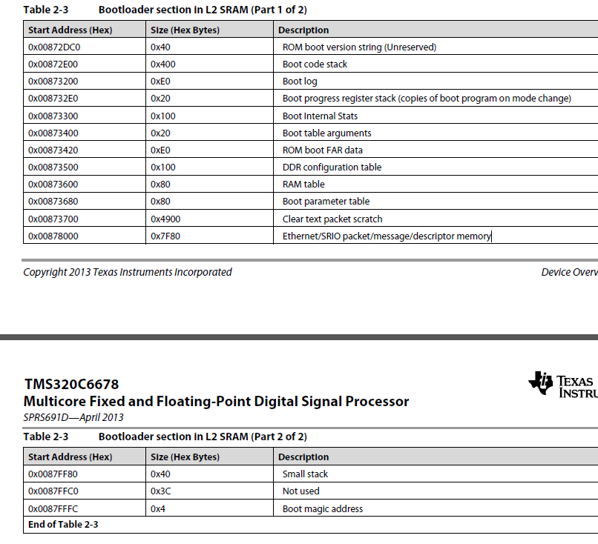
Boot Process Memory Usage and Magic address (1)
DSP boot uses part of L2 for the boot process
Address depends on the device, for 6678 starts at 0x0087 2DC0

Slide 15
Boot Process Memory Usage and Magic address (2)
Notice that this address is usually where L2 cache is
Do not put code or initialized memory in these locations
Magic Address – the address to where a core goes after the boot process (idle, after it gets an interrupt)
The last 4 bytes of L2, for 6678 it is 0x0087 fffc (local)
The boot process must enter this address before generating interrupt for all the cores
Obviously, the boot process must use the global address
What about ARM boot?
Different magic address for different boot, will see later

Slide 16
KeyStone PLL Settings
The user can set the different PLL settings for the proper operation of the device
Each device data manual has one or more PLL tables
The System PLL settings is used for setting the system clock configuration.
ARM PLL settings is used for the ARM clock speed configuration.
PA PLL settings is used for the PA clock configuration.

Slide 17
Example of PLL Configuration
The boot code sets the PLL multiplier based on the core frequency set in the EFUSE register
PLL Clock Configuration for KeyStone Devices
Boot PLL Select [2:0] | Input Clock Freq (MHz) | core = 800 MHz |  | core = 1000 MHz |  | core = 1200 MHz |  | core = 1400 MHz
 |  | Clkr | Clkf | Clkr | Clkf | Clkr | Clkf | Clkr | Clkf
0 | 50.00 | 0 | 31 | 0 | 39 | 0 | 47 | 0 | 55
1 | 66.67 | 0 | 23 | 0 | 29 | 0 | 35 | 0 | 41
2 | 80.00 | 0 | 19 | 0 | 24 | 0 | 29 | 0 | 34
3 | 100.00 | 0 | 15 | 0 | 19 | 0 | 23 | 0 | 27
4 | 156.25 | 24 | 255 | 4 | 63 | 24 | 383 | 24 | 447
5 | 250.00 | 4 | 31 | 0 | 7 | 4 | 47 | 4 | 55
6 | 312.50 | 24 | 127 | 4 | 31 | 24 | 191 | 24 | 223
7 | 122.88 | 47 | 624 | 28 | 471 | 31 | 624 | 13 | 318
PLL Clock O/P = (Input Clock x (Clkf + 1))/(2 * (Clkr + 1))

Slide 18
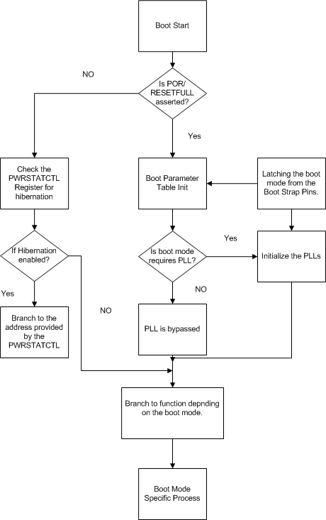
RBL Flow
Diagram

Slide 19
Agenda
Boot Modes
configuration pins
magic address
triggering and reset

Slide 20
keyStone I Boot Configuration Pins
Boot mode and configurations are chosen using bootstrap pins on the device.
Pins are latched and stored in13 bits of the DEVSTAT register during POR.
The configuration format for these 13 bits are shown in the table:
Boot Device [2:0] is dedicated for selecting the boot mode
Device Configuration [9:3] is used to specify the boot mode specific configurations.
PLL Multi [12:10] are used for PLL selection. In case of I2C/SPI boot mode, it is used for extended device configuration. (PLL is bypassed for these two boot modes)
Boot Mode Pins
12 | 11 | 10 | 9 | 8 | 7 | 6 | 5 | 4 | 3 | 2 | 1 | 0
PLL Mult I2C/SPI Ext Dev Cfg |  |  | Device Configuration |  |  |  |  |  |  | Boot Device

Slide 21
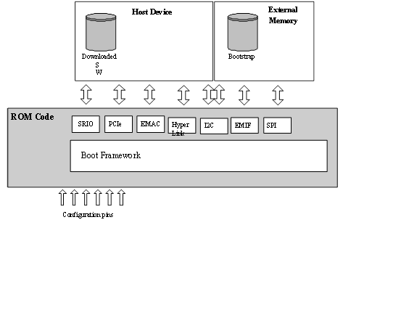
KeyStone I ROM Boot Modes
Ethernet Boot (boot from external host connected through Ethernet)
PCIe Boot (boot from external host connected through PCIe )
HyperLink Boot (boot from external host connected through HyperLink)
EMIF16 NOR Boot(boot from NOR Flash)
Device Manual will detail supported types.
Some members have NAND boot as well
I2C Boot
Master Boot (from I2C EEPROM)
Master-Broadcast Boot(Master Boot followed by broadcast to slave cores)
Passive Boot (external I2C host)
SPI Boot (from SPI flash)
SRIO Boot(from external host connected through SRIO)

Slide 22
KeyStone I Boot Device
Boot Device Selection Values
For interfaces supporting more than one mode of operation, the configuration bits are used to establish the necessary settings
Boot Mode Pins: Boot Device Values
Value | Boot Device
0 | Sleep(6670) / EMIF16¹
1 | Serial Rapid I/O
2 | Ethernet (SGMII) (PA driven from core clk)
3 | Ethernet (SGMII) (PA driver from PA clk)
4 | PCIe
5 | I2C
6 | SPI
7 | HyperLink
1. See the device-specific data manual for information.

Slide 23
KeyStone II Boot Modes and ARM master boot
The different boot methods are:
Sleep boot
I2C master boot
SPI boot
NAND boot
XIP boot
UART boot
Ethernet boot
SRIO boot
HyperLink boot
PCIe boot
The various boot mode available depend on the device used.
To select the boot mode refer to the data manual for the different options available

Slide 24
KeyStone II boot strap selection
DEVSTAT Boot Mode Pins ROM Mapping
16 | 15 | 14 | 13 | 12 | 11 | 10 | 9 | 8 | 7 | 6 | 5 | 4 | 3 | 2 | 1 | Mode
X | X | 0 | Arm en | Sys en | ARM PLL Cfg |  |  | Boot Master | Sys PLL Cfg |  |  | min | 0 | 0 | 0 | Sleep
Slave Addr |  | 1 | Port |  | ARM PLL Cfg |  |  |  |  |  |  |  | 0 | 0 | 0 | I2C Slave
X | X | X | Bus Address |  | Param Idx / Offset |  |  |  | X | Port |  |  | 0 | 0 | 1 | I2C Master
width | csel |  | mode |  |  |  |  |  | Npin |  |  |  | 0 | 1 | 0 | SPI
0 | base |  | wait | width | ARM PLL Cfg |  |  |  | Sys PLL Cfg |  |  | 0 | 0 | 1 | 1 | XIP (ARM Master)
 |  |  |  |  | X | Chip sel |  |  |  |  |  |  |  |  |  | XIP (GEM Master)
1 | First Block |  |  | Clear | ARM PLL Cfg |  |  |  |  |  |  | min |  |  |  | NAND (ARM Master)
 |  |  |  |  | X | Chip Sel |  |  |  |  |  |  |  |  |  | NAND (GEM Master)
lane | Ref Clock |  | Data Rate |  | ARM PLL Cfg |  |  |  |  |  |  |  | 1 | 0 | 0 | SRIO (ARM Master)
X |  |  |  |  | Lane Setup |  |  |  |  |  |  |  |  |  |  | SRIO (GEM Master)
Pa clk | Ref Clk |  | Ext Con |  | ARM PLL |  |  |  |  |  |  |  | 1 | 0 | 1 | Ethernet (ARM Master)
 |  |  |  |  | rsvd | Lane Setup |  |  |  |  |  |  |  |  |  | Ethernet (GEM Master)
Ref clk | Bar Config |  |  |  | ARM PLL |  |  |  |  |  |  | 0 | 1 | 1 | 0 | PCIe (ARM Master)
 |  |  |  |  | SerDes Cfg |  |  |  |  |  |  |  |  |  |  | PCIe (GEM Master)
Port | Ref Clk |  | Data Rate |  | ARM PLL |  |  |  |  |  |  | 1 | 1 | 1 | 0 | Hyperlink (ARM Master)
 |  |  |  |  | SerDes Cfg |  |  |  |  |  |  |  |  |  |  | Hyperlink (GEM Master)
X | X | X | X | Port | ARM PLL |  |  |  | Sys PLL Cfg |  |  | min | 1 | 1 | 1 | UART (ARM Master)
X | X | X | X |  | X | X | X |  |  |  |  |  |  |  |  | UART (GEM Master)

Slide 25
Triggering the BOOT process
Triggers are mechanisms that initiates the execution of the RBL. KeyStone devices use resets as triggers.
Four types of resets:
Power on Reset (PoR)
Reset Full
Reset
Local Reset

Slide 26
Reset Types
Power on Reset (POR) (Cold Reboot)
Resets everything
Latches the boot strap pins
RBL Process initiated
RESETFULL (Warm Reboot)
Resets everything
Latches the boot strap pins
RBL Process initiated
RESET (Can be configured as hard or soft)
Resets everything except EMU and reset isolated peripherals.
No latching of the boot strap pins.
For software reset PCIe, EMIF16, DDR3 and EMIF MMRs are also preserved.
RBL process is initiated.
LRESET
Mostly used by watch dog timer
Just the CorePac is reset all the memory are preserved.
No RBL process is initiated.

Slide 27
Agenda
File formats
DSP formats
ARM formats
TI Tools

Slide 28
KeyStone I Boot Formats
Boot Parameter Table is a configuration table, part of the boot process table. It contains two parts:
Common set of parameters for system configuration
Unique parameter settings for each boot method
Masters boot modes expect two tables
Boot Table contains code that needs to be loaded into the device.
Boot Configuration Table is a register configuration table that is used to manipulate memory map register.

Slide 29
Boot Parameter Format
Boot Parameter Table:
Provides a “map” for the boot process
The boot process copies a default Boot Parameter Table into a reserved L2 of Core 0.
The first 10-byte offsets of the Boot Parameter Table are common across all the boot modes:
Length
Checksum
Boot Mode
Port Num
PLL configuration (most significant bits)
PLL configuration (least significant bits)
The rest of the Boot Parameter Table is boot-mode dependent.

Slide 30
Boot Image Format
Boot Table:
Block of data that contains the code and data section
The block is loaded from the host or external memory to the internal memory or DDR by the RBL.
The first 8 bytes of the Boot Table form the header:
32-bit section bytes count
32 bit section address where the block has to be moved
The end of table is identified by writing 0s.

Slide 31
Register Configuration Format
Boot Configuration Table:
Provides read/modify/write capabilities to any memory on the device.
Each entry has three 32-bit-wide elements.
First element is the address to be modified
Second element is the set mask
Third element is the clear mask
If all three elements are 0s, this indicates the end of the Boot Configuration Table.

Slide 32
What about Slave Modes
The master should take care of loading the code and do the MMR configurations
TI provides set of tools to help

Slide 33
KeyStone II ARM Boot Image formats (1/4)
BLOB format
Binary Large Object
Treats the executable as a data byte stream
The BLOB will cover the entire memory location used by the application
When the BLOB is received, the RBL will load it in the base of MSMC.
Once the blob loading is complete, the RBl jumps the core0 PC to base of MSMC and starts executing.
Magic address of the ARM:
Core 0 – 0x0C5A D000, Core 1- 0x0C5A D004, core 2 – 0x0C5A 0008, core 3 – 0x0C5A D00C

Slide 34
KeyStone II ARM Boot Image formats (2/4)
Tools to build the blob
armhex – convert the .out file into an ASCII hex file
b2ccs.exe – converts the ASCII hex file into a CCS .dat format
ccs2bin.exe – converts the CCS .dat format to a blob which is used for UART or Ethernet boot

Slide 35
KeyStone II ARM Boot Image formats (3/4)
GP header format
Similar to boot table for DSP boot
Unlike boot table there is no start address
Format is
Block 0 length
Block 0 Base Address
Block 0 data
…
Block last length
Block last base address
Block last data
Termination (0 for block length)

Slide 36
KeyStone II ARM Boot Image formats (3/4)
Tools to build the GP format
catccs – combines the data contents of two CCS .dat files while updating the CCS .dat header to be the correct combined length
ccsAddGphdr – adds a general purpose header to your CCS .dat file and also updates the CCS .dat header to account for the added 8 bytes of length
32 bits for the length of the data section
32 bits for the destination address of the data section
ccsAddGptlr – adds a general purpose tail to your CCS .dat file and also updates the CCS .dat header to account for the added 8 bytes of length
32 bits of all zeroes
32 bits of all zeroes
During boot, once the end of table is reached, RBL jumps to the base address of the last block

Slide 37
Tool Support (1/3)
DSP code is generated by TI code generation family and has XXX.out format
Coeff format was TI proprietary format
Alf (eabi) is an industry standard format
Hex6x tool converts out format into hex ASCII format
It can produce these output file formats:
ASCII-Hex, supporting 16-bit addresses
Extended Tektronix (Tektronix)
Intel MCS-86 (Intel)
Motorola Exorciser (Motorola-S), supporting 16-bit addresses
Texas Instruments SDSMAC (TI-Tagged), supporting 16-bit addresses

Slide 38
Tool Support (2/3)
Hex6x is described in TI assembly tools User Guide http://www.cs.cmu.edu/afs/cs/academic/class/15745-s05/www/c6xref/assembly.pdf
Armhex is similar to hex6x and is described in ARM Assembly Language tool User Guide (SPNU118L)
The next slide shows a sample of hex converter out for booting from 8-bit SPI boot

Slide 39
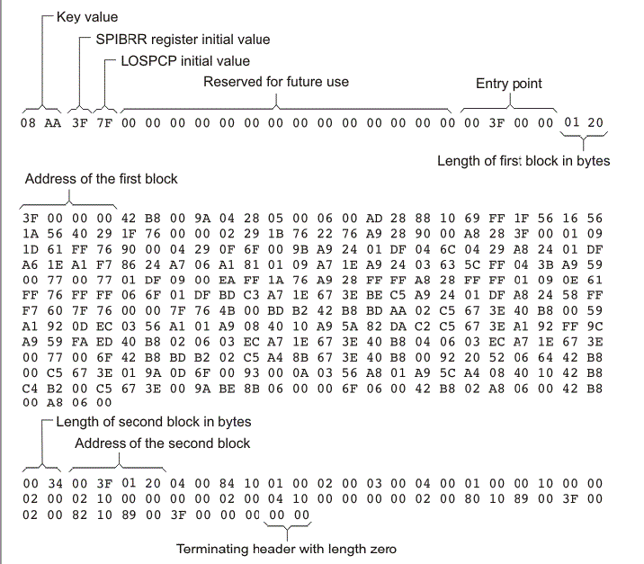

Slide 40
Tool Support (3/3)
Building the boot table:
If the EVM is set in little endian mode, convert the boot table to big endian mode (used by the RBL) using the bconvert64x utility (available in MCSDK).
Convert to an I2C format (to be loaded into the EEPROM) using the b2i2c utility (available in MCSDK).
Append the boot parameter table to the boot table using romparse (Available in MCSDK), which uses a map file to retrieve the boot parameter tables.

Slide 41
Agenda
modes details
DSP
ARM

Slide 42
KeyStone I Boot(1/2)
The image is converted into the boot table using hex6x.
The the image is sent by the host one section at a time in case of the host boot method.
Messaging SRIO boot
Ethernet boot
UART boot
The master core running the RBL will read sections from the memory in case of mem boot
I2C boot
SPI boot
NAND boot

Slide 43
Boot Process: Boot Table (2/2)
The RBL also reads the start address and populate the Boot Magic Address
Once all the sections are loaded, the master core jumps to the address specified in BMA and start executing.

Slide 44
KeyStone I I2C Master Boot
PLL is in bypass mode.
Can be used to run a work-around before running the main boot method
Can modify the boot parameter table that is used by RBL.
After running the work-around, can modify the boot parameter table to boot in another boot method.
Images are stored in the EEPROM in two pages that are divided into blocks of 0x80 bytes.

Slide 45
KeyStone I I2C Passive Mode
Passive mode
The I2C device configuration uses 5 bits of device configuration instead of the 7 bits used in master mode.
The device does not drive the clock, but simply acks data received on the specified address.
The I2C address is calculated by adding 0x19 to the I2C address specified in the device configuration.
Header format: (0x19 + I2C address) xx xx yy yy zz zz where:
xx xx = length
yy yy = checksum
zz zz = boot option

Slide 46
KeyStone I XIP Boot
The XIP boot mode does not fit in either the direct image or boot table mode of booting.
After the initialization, the master core jumps to the 0x70000000 address and starts executing.

Slide 47
KeyStone I SPI Boot
Same as I2C mode
The only difference is that instead of pages, the NOR flash is selected based on the chip select.

Slide 48
KeyStone I Ethernet boot
The RBL configures the SERDES, NETCP (if available on the device), and starts transmitting the Ethernet-ready packet.
The PHY is NOT configured.
The host can use the Ethernet-ready packet to generate the image packets to transmits into the device.

Slide 49
KeyStone I SRIO Boot
RBL configures the SRIO to operate both in messaging mode and DirectIO mode.
In messaging mode, the SRIO boot is similar to the Ethernet boot.
In DirectIO mode, the master core is in poll mode, polling the BMA.
Once the host loaded all the sections of the image, it should populate the BMA.

Slide 50
KeyStone I PCIe Boot
RBL configures the device in Endpoint mode.
RC mode is NOT supported.
The PCIe boot process is similar to DirectIO SRIO boot.
One difference is that the master core is in idle state and the RC should wake the core by sending a legacy or MSI interrupt after loading the image and BMA.

Slide 51
Boot Configuration – PCI Express
BAR Config / PCIe Window Sizes
 |  | 32 bit Address Translation |  |  |  |  | 64 bit Address Translation
BAR cfg | BAR0 | BAR1 | BAR2 | BAR3 | BAR4 | BAR5 | BAR1/2 | BAR3/4
0b0000 | PCIe MMRs | 32 | 32 | 32 | 32 | Clone of BAR4
0b0001 |  | 16 | 16 | 32 | 64
0b0010 |  | 16 | 32 | 32 | 64
0b0011 |  | 32 | 32 | 32 | 64
0b0100 |  | 16 | 16 | 64 | 64
0b0101 |  | 16 | 32 | 64 | 64
0b0110 |  | 32 | 32 | 64 | 64
0b0111 |  | 32 | 32 | 64 | 128
0b1000 |  | 64 | 64 | 128 | 256
0b1001 |  | 4 | 128 | 128 | 128
0b1010 |  | 4 | 128 | 128 | 256
0b1011 |  | 4 | 128 | 256 | 256
0b1100 |  |  |  |  |  |  | 256 | 256
0b1101 |  |  |  |  |  |  | 512 | 512
0b1110 |  |  |  |  |  |  | 1024 | 1024
0b1111 |  |  |  |  |  |  | 2048 | 2048

Slide 52
Boot Configuration HyperLink Mode
HyperLink boot mode boots the DSP through the ultra short range HyperLink.
The host loads the boot image directly through the link and then generates the interrupt to wake the DSP.
MCM Boot Device Configuration
9 | 8 | 7 | 6 | 5 | 4 | 3
Reserved | Data Rate |  | Ref Clock |  | SR Index
MCM Boot Device Configuration Field Descriptions
Bit Field | Value | Description
SR Index | 0-3 | Smart Reflex Index
Ref Clock | 0 | 156.25 MHz
 | 1 | 250 MHz
 | 2 | 312.5 MHz
Data Rate | 0 | 1.25 GBs
 | 1 | 3.125 GBs
 | 2 | 6.25 GBs
 | 3 | 12.5 GBs

Slide 53
KeyStone II Boot Loading Process - I2C Boot
PLL are bypassed in this mode.
The application to be loaded is converted into a GP header format table and loaded in the EEPROM.
Generally a two stage bootloader process is carried out.
First stage will load the image that has the PLL settings and modifies the boot parameter table to point to the next address in EEPROM where the real image is loaded. Then re-enter the RBL
In second stage the real image is loaded.

Slide 54
KeyStone II Boot Loading Process -XIP boot
The image to be loaded is in the GP header format and loaded in the EMIF NOR flash.
Once the boot is triggered, the GP header blocks are loaded based on the base address and the byte size.
Once the last block is detected, the RBL branches ARM core0 to the base address specified in that block and starts executing.
See device Errata

Slide 55
KeyStone II Boot Loading Process - SPI boot
PLL are bypassed in this mode.
The application to be loaded is converted into a GP header format table and loaded in the SPI flash.
Generally a two stage bootloader process is carried out.
First stage will load the image that has the PLL settings and modifies the boot parameter table to point to the next address in flash where the real image is loaded. Then re-enter the RBL
In second stage the real image is loaded.

Slide 56
KeyStone II Boot Loading Process - Ethernet boot
The RBL configures the SERDES, NetCp (if available) and starts transmitting the Ethernet ready packet.
The PHY is NOT configured buy the boot process (external logic)
The RBL sends the BOOTP packet which is answered by a DHCP server.
The Server assigns an IP address to the device and also sends the server address and the file to be loaded.
The RBL receives this information and starts downloading the image in the BLOB format to MSMC.
Once the downloading completes, the ARM core0 PC is modified to base of MSMC and starts executing the code.

Slide 57
KeyStone II Boot Loading Process - SRIO Boot
RBL configures the SRIO to operate both in messaging as well as directIO mode.
In messaging mode the SRIO boot expects the application in a GP header format.
In directIO, the ARM core0 will be in a poll mode, polling ARM magic address.
The host will load the different sections in the blob format and also updates the ARM magic address.
Once the address becomes non zero, the ARM core0 jumps to the address specified in the ARM magic and start executing the application.

Slide 58
KeyStone II Boot Loading Process - PCIe Boot
RBL configures the device in Endpoint mode.
RC mode is NOT supported.
The RBL configures the SERDES, BAR registers and the window width.
The host can then load the image in the device in the blob format.
Once the loading is complete, the host need to set the ARM magic address to the start of the application.
Then the host wakes up the ARM using the MSI interrupt.
The ARM wakes up and branches to the address specified in the ARM magic address and starts executing.

Slide 59
KeyStone II Boot Loading Process - HyperLink Boot
RBL configures the device hyperlink window.
The RBL configures the SERDES.
The host can then load the image in the device in the blob format.
Once the loading is complete, the host need to set the ARM magic address to the start of the application.
Then the host wakes up the ARM using the hyperlink interrupts.
The ARM wakes up and branches to the address specified in the ARM magic address and starts executing.

Slide 60
KeyStone II Boot Loading Process – NAND Boot
The application needs to be in the GP header format
The application is first flashed in the NAND blocks.
The RBL is told the 1st block to look for the image.
The process is then same as the I2C or SPI.

Slide 61
KeyStone II Boot Loading Process – UART Boot
The RBL configures the UART and starts sending pings.
The host can send the blob using the XMODEM protocol.
Once the end of the blob is reached, the RBL jumps the ARM core0 to base of MSMC and starts executing the code.

Slide 62
Agenda
Two step boot
IBL
Boot multiple cores
U-boot

Slide 63
Second Stage Boot Load Process
Q: What if more boot parameters are needed than can be specified in the boot pins?
A: Other parameter values can be updated through the I2C boot mode.
In this case, the I2C boot starts with an I2C boot parameter table which in turn loads a custom updated parameter table for a specific boot mode.
Once the default parameter table is updated, the boot code executes using the updated boot parameter structure, following the same process as the primary boot mode.

Slide 64
Second Stage Boot Load Specifics
The loaded EEPROM image has two boot parameter table blocks.
The first block is an I2C boot parameter table, which sets the core clock and the address of the next block.
The next block includes the requested boot mode-specific boot parameter table with user-specified values.
After loading this image into the EEPROM, the boot mode in the boot strap is set for I2C master boot.
After POR, the I2C boot code is executed as a first-stage boot load, which updates the default boot parameter table and re-enters the boot code, executing the boot code utilizing the user-specific parameters.

Slide 65
Intermediate Boot Loader (IBL)
Originally created as a work-around for a PLL locking issue in the C667x PG1.0 version.
Same process as second stage boot loading.
Also provides additional boot features:
TFTP boot
NAND boot
NOR boot
In the EVM, the FPGA is programmed to boot IBL, execute the PLL fix, and then jump right back to RBL for the set boot mode.

Slide 66
KeyStone I Booting Multiple Cores
During the boot process, the boot loader code is loaded into the L2 of CorePac 0 from the ROM.
The high 0xD23F (52K) bytes of L2 in all CorePacs are reserved for the boot code. User should not overwrite this area.
All the other cores will execute an IDLE.
User should load the image into the L2 of CorePacs they want to boot.
Before setting the Boot Complete register, the user should also set the start address of the code in the respective BOOT MAGIC ADDRESS of the CorePac L2.
Finally, the user image should also write the IPC Interrupt register to bring the required CorePacs out of IDLE.

Slide 67
KeyStone II Booting Multiple cores
ARM core0 is the master core.
During the boot process the other ARM cores if available are shut down.
The application that is running in ARM core0 needs to update the ARM magic address and then power up the other ARM cores in the tetras.
Once powered up the other ARM cores will start executing from the address specified in the ARM magic address.

Slide 68
U_BOOT (1/2)
U-BOOT is an open source cross-platform boot loader application that facilitate loading images and more
In addition to configure the hardware, the U-BOOT enables the user to
read and write arbitrary memory location
loading image into RAM
Copying data into the flash
Provide starting address for the code

Slide 69
U_BOOT (2/2)
U-BOOT monitor application enables controlling U-BOOT from external terminal
The user can define a set of parameters (Environment variables) that controls the BOOT process. These parameters are stored in flash.
U-BOOT has a set of commands
Setenv – define an environment variable
Printenv – shows the current parameters (environment variables)
Saveenv – save new setting into the flash
The next slide shows part of the printenv results for my EVM

Slide 70
TCI6638 EVM # printenv
addr_uboot=0x87000000
args_all=setenv bootargs console=ttyS0,115200n8 rootwait=1
args_net=setenv bootargs ${bootargs} rootfstype=nfs root=/dev/nfs rw nfsroot=${serverip}:${nfs_root},${nfs_options} ip=192.168.0.53:::::eth0:off
args_ramfs=setenv bootargs ${bootargs} earlyprintk rdinit=/sbin/init rw root=/dev/ram0 initrd=0x802000000,80M
boot=net
bootcmd=run init_${boot} get_fdt_${boot} get_mon_${boot} get_kern_${boot} run_mon run_kern
gatewayip=192.168.0.1
get_fdt_ramfs=tftp ${addr_fdt} ${tftp_root}/${name_fdt}
get_mon_net=tftp ${addr_mon} ${tftp_root}/${name_mon}
init_net=run args_all args_net
init_ramfs=run args_all args_ramfs get_fs_ramfs
ipaddr=192.168.0.53
mem_lpae=1
mem_reserve=512M
name_fdt=uImage-k2hk-evm.dtb
name_fs=tisdk-rootfs.cpio.gz
nfs_options=v3,tcp,rsize=4096,wsize=4096
nfs_root=/opt/filesys/student3
run_kern=bootm ${addr_kern} - ${addr_fdt}
run_mon=mon_install ${addr_mon}
serverip=192.168.0.100
tftp_root=student3

Slide 71
Questions? Thanks !

Slide 72
Back Up

Slide 73
Hibernation
Hibernation 1
The application needs to ensure that the chip control register is set correctly to avoid MSMC reset.
Hibernation 2
MSMC is reinitialized to default values.
For both modes, the Application is responsible for shutdown of all desired IP blocks.
A hard or soft reset can be configured to bring a hibernating device out of hibernation
After the reset, the boot loader code checks the PWRSTATECTL register to identify the hibernation mode and branch address and recovery master.
Subsequent Actions
Peripherals and CorePacs are powered
The awakened device branches to the application code which utilizes the values stored in MSMC or DDR3 prior to hibernation and the recovery master starts the recovery process.

